Slide 1
Objectives
In this session, you will learn to:
  Understand the basic concepts of excise duty
  Understand the salient features of excise in Tally.ERP 9
  Enable excise in Tally.ERP 9
  Understand the method of apportion

Slide 2
Registration of Manufacturers
Every manufacturer of excisable goods on which excise duty is leviable or persons who desire to issue CENVATABLE invoices under the provisions of the CENVAT Credit Rules, 2001 are required to be registered as per the procedure prescribed in Rule 9 of Central Excise (No. 2) Rules 2001.
The registration is valid only for the premises it is granted.

Slide 3

Registration of Manufacturers (Contd.)
The registration numbers are PAN based 15 digit alpha numeric. The first part denotes 10 character (alpha numeric) Permanent Account number issued by Income tax authorities and the second part comprises of a fixed 2 character alpha code, as shown in the following figure.
The character alpha code is followed by a three character numeric.

Slide 4
Requirements of Excise Invoice
The Registered Location of a manufacturer is required to issue invoice in the prescribed format.
The invoice should contain the following details:
  Minimum four copies of Invoice are required to be prepared.
  The dealer is required to issue only one invoice in respect of the consignment wherein all the packages are dispatched in one lot.
  The copies of the invoices issued by a first stage dealer and a second stage dealer shall be marked at the top as First Stage Dealer and Second Stage Dealer respectively.

Slide 5
Requirements of Excise Invoice (Contd.)
  The following details should be pre-printer on the Invoice:
    Name
    Address
    Central Excise Registration Number of the registered location issuing the invoice
    Name of the jurisdictional range or division or commissionerate
    Company’s income tax number
    Company ‘s sales tax registration number
  Only one invoice book of each type shall be used by the registered location.
  Each CENVAT Invoice issued by the location should bear a printed serial number, beginning from 1st April of the year.

Slide 6
Requirements of Excise Invoice (Contd.)
  The serial numbers of the invoices to be used are to be intimated to the respective jurisdictional Assistant Commissioner of Central Excise and obtain a dated acknowledgement of such intimation.
  Records and Invoice generated through computer are also recognized. In that case, the serial number likely to be used in the forthcoming quarter should be intimated to the Asst. Commissioner.
  In case of Records and Invoice generated through computer, the serial number likely to be used in the forthcoming quarter should be intimated to the jurisdictional Assistant Commissioner of Central Excise.

Slide 7

Types of Duties and Method of Calculation
The following embedded documents contains the table displaying the various types of duties and method of calculation.

Slide 8
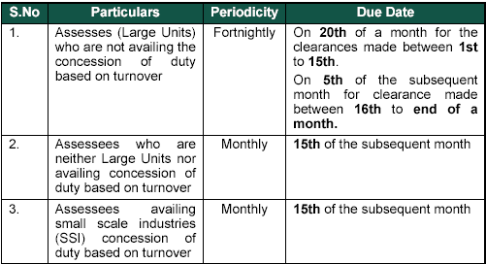
Time and Mode of Payment of Duty
The following figure shows the time and mode of payment of duty.

Slide 9
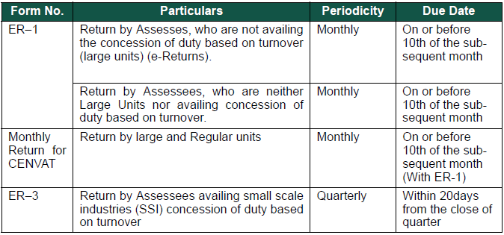
Returns and Timelines
The Returns required to be filed under Excise for Manufacturers are displayed, as shown in the following figure.

Slide 10
Salient Features of Excise in Tally.ERP 9
The following are the salient features of the excise in Tally.ERP 9:
  Simple and user-friendly.
  Easy to setup and use.
  Allows multiple excise units (manufacturer as well as dealer) in a single company.
  Allows Tariff (HSN) or commodity code for excisable items.
  Facilitates various Excise duty parameters.
  Generate excise invoice as per Rule 11 of Excise Rules 2001.
  Allows additional ledgers such as expenses or incomes to form part of Assessable value.

Slide 11
Salient Features of Excise in Tally.ERP 9 (Contd.)
  Allows calculation of duty for different Items under different valuation methods in a single invoice.
  Allows recording of exempt, export and special rate transactions.
  Facilitates reversal of CENVAT credit and also full or partial CENVAT credit on inputs and capital goods or service tax towards duty payable.
  Generate and print excise payment challan in G.A.R-7 Challan.
  Generate excise reports.

Slide 12
Demo: Enabling Excise in Tally.ERP 9
Problem Statement:
  Let us consider the example of M/s. Metal Craft Engineering Pvt. Ltd., who are engaged in the business of manufacturing Hot Rolled Beams, Cold Rolled Channels, Slotted angles and so on.

Slide 13

Demo: Enabling Excise in Tally.ERP 9 (Contd.)
Let us see how to enable
excise in Tally.ERP 9.

Slide 14
Method of Apportion
The following are the various types of method of apportion used in Tally.ERP 9:
  Based on Value:
    If Based on Value method of apportion is selected, the expenses will be apportioned based on the Value of the Stock item.
  Based on Quantity:
    If Based on Quantity method of apportion is selected, the expenses will be apportioned based on the quantity of the Stock item.

Slide 15
Summary
In this session, you learned that:
  Tally.ERP 9 permits you to create specific voucher types like Excise-Purchase and Excise-Sales for entering the excise related transactions.

